Slide 1

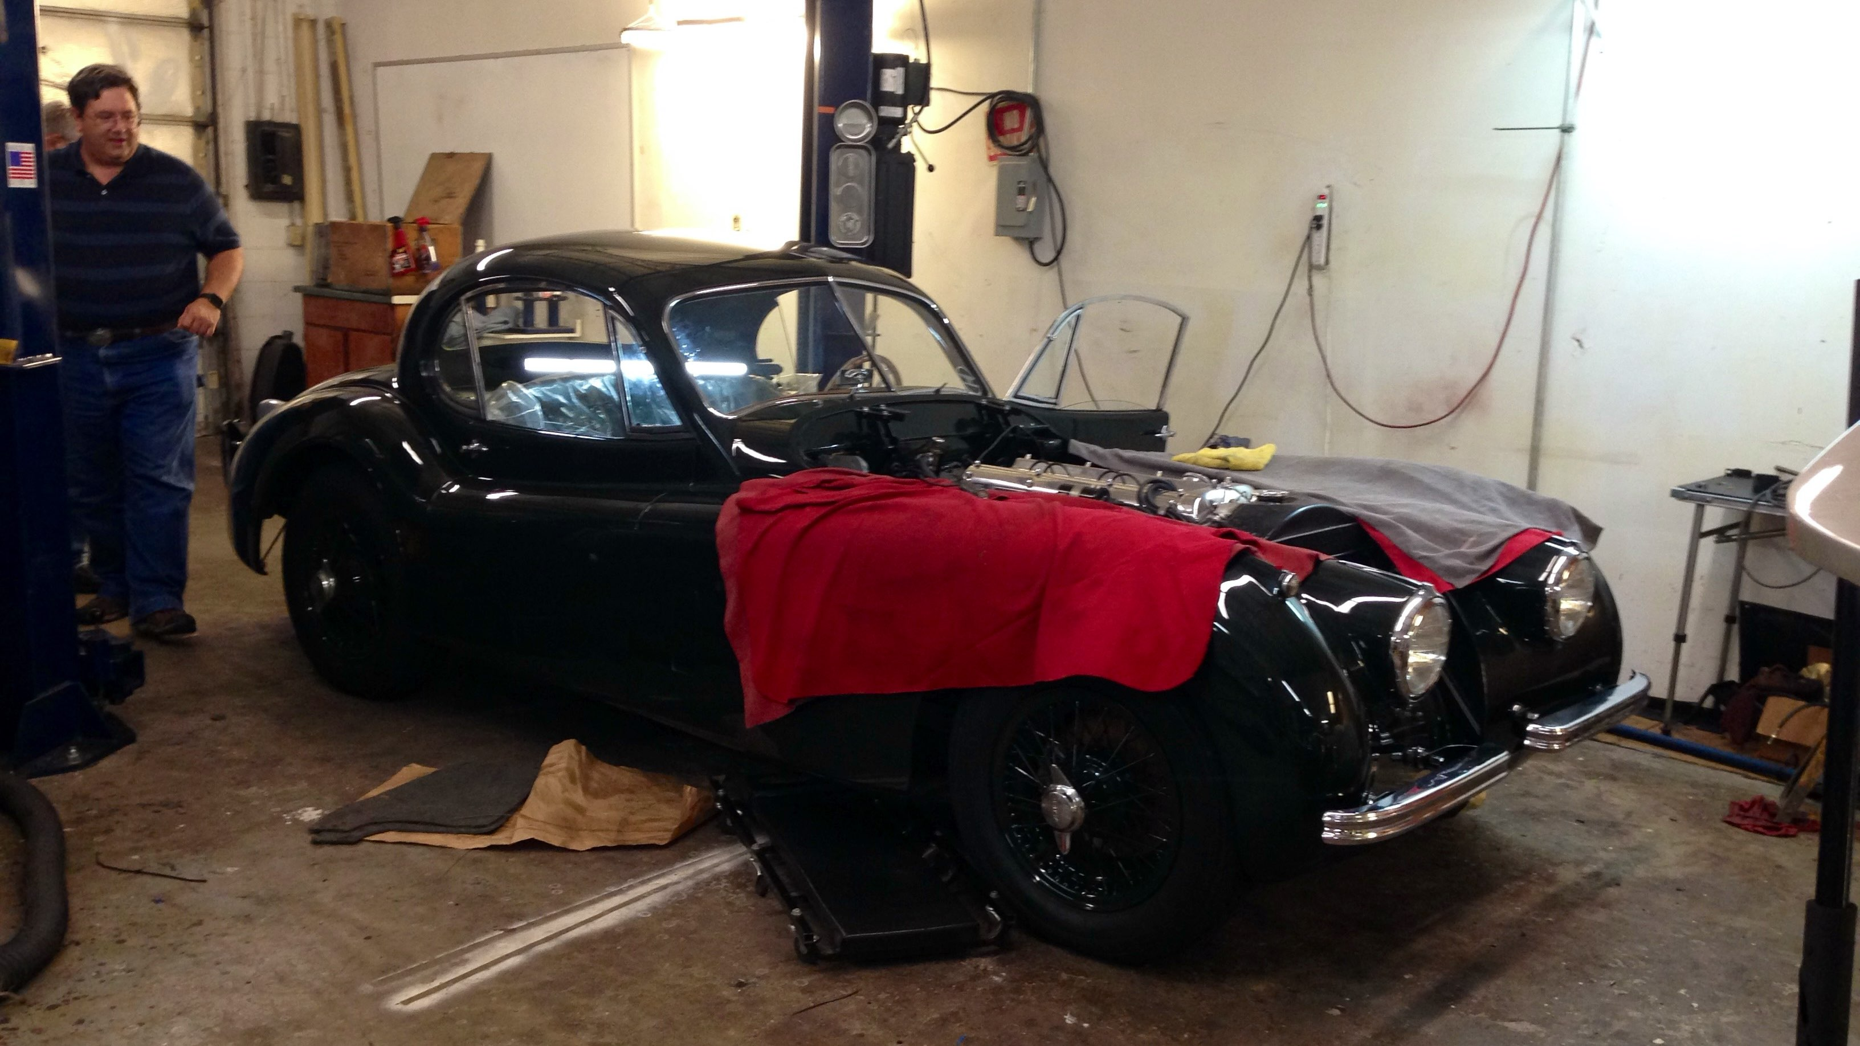




D-302 - Tales from Under the Hood
Part 1
Scan to Leave Feedback
with David Simpson
& Claris Engineers
Sat Aug 8th, 1:30 pm Pacific
Simpson visiting Maeckel garage courtesy of ChatGPT

Slide 2
FileMaker ODBC - Windows 11 ARM
Use Cases:
    Access, Visual FoxPro, SQL Server, MySQL to FileMaker Pro Data Transfers via ODBC
    Apple Silicon & Parallels - Windows 11 ARM Development
      macOS 26 - Last supported version for x86_64
    Microsoft Surface Pro running Windows 11 ARM
Confirm Fixed with FM 2026:
Windows ARM Officially Supported?
David Simpson

Slide 3
ODATA with FileMaker (Pro)?
Future:
    ODATA will be the basis for the ODBC driver in the future
    ODATA would need implemented in FileMaker Pro (not just server)
Maybe this could be used by AI models to work with the database (server or Pro):
David Simpson

Slide 4
Discussion
Presenters

Slide 5
Scan to Leave Feedback
David Simpson

